Slide 1

Welcome to English for Science
Week 1

Slide 2
Your Teacher…
Catriona Hope
Lectrice
Catriona.hope@unicaen.fr
Office number: li 368

Slide 3
Aim for this course
To practice written and oral English. Whilst also improving reading comprehension and expression
We will do this through the use of videos, audio tapes and articles.
We will also be aiming to finish the course with a B2 level of English.

Slide 4
Expectations and Grading
We will have 8 weeks of classes for General English and four week of classes for anglais approfondi (specialised English) this semester.
This semester there will be two Exams and we will give you the dates for these as soon as we have them.
Of course there will be grammar exam to start with so you should really revise this over the next few weeks!
There will also be an exam for Anglais approfondi at the end of the semester so make sure to attend every class!
Attendance is mandatory!

Slide 5
Introduce yourselves…
Talk with the person next to you and find out…
Their Name
Where they are from
What course they are studying and why
What they did over the summer
Their favourite food.
Remember: Write this information down as I will be asking some people to tell me what their partner said.

Slide 6
This weeks Aim:
Grammar Revision and Listening comprehension

Slide 7
Present Continuous
Sarah is in her car. She is on her way to work. She is driving to work.
The action happens now at the time of speaking, it is not yet finished

Slide 8
Construction: Affirmative
Present tense ‘to be’
+ infinitive of verb / base verbale
+ -ing
I am /I’m
You are / You’re
He/She/It is He’s/She’s/It’s + infinitive + -ing
We are / We’re
You (all) are
They are / They’re

Slide 9
Examples
E.g. I am driving
I am washing
I am eating
I am drinking

Slide 10
Construction Negative
Present tense ‘to be’
+ not
+ infinitive of verb / base verbal
+ -ing
I am not
You are not
He/She/Its is not +infinitive + -ing
We are not
You (all) are not
They are not

Slide 11
Examples
E.g. I am not driving

Slide 12
Construction: Question
Present tense ‘to be’ reversed
+ infinitive of verb / base verbal
+ -ing
Am I
Are you
Is he/she/it + infinitive + -ing
Are we
Are you (all)
Are they

Slide 13
Example
E.g. Are you driving?

Slide 14
Present Simple
Used when talking about things in the present in general e.g. I study science
I am not studying science right now, but I generally do
Something that happens all the time/repeatedly

Slide 15
Construction: Affirmative
Subject: I / You / He / She / We / You (all) / They
+ base verbal / infinitive of verb
DON’T FORGET do add an –s to the verb in third personal singular in the affirmative only
E.g. she works / he lives / it sounds
they work / I live / we sound

Slide 16
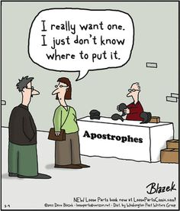
Construction: Negative
I/ you / we / you / they + do not/don’t + base verbale
OR
He / She / It + does not/ doesn’t + base verbal
E.g. I don’t work
E.g. He doesn’t work

Slide 17
Construction: Question
Do + I / you / we / they + base verbal + ?
OR
Does + he / she /it + base verbal + ?
E.g. Do you work?
E.g. Does he work?

Slide 18
NOTE
Irregular verbs!!
to have
to be
to do

Slide 19
Comparison
Present continuous (I am doing) → things happening at or around time of speaking
The action is not yet complete
E.g. The water is boiling, can you turn it off?
Present simple (I do) → things in general or that happen repeatedly
E.g. Water boils at 100 degrees Celsius.

Slide 20
Exercises: PRESENT CONTINUOUS OR PRESENT SIMPLE
Are the underlined verbs right or wrong? Correct them where necessary .
Water boils at 100 degrees Celsius.
The water boils. Can you turn it off?
Look! That man tries to open the door of your car.
Can you hear those people? What do they talk about?
The moon goes round the earth in about 27 days.
I must go now. lt gets late. 'Hurry up! lt's time to leave.' 'OK, I come.'
I hear you've got a new job. How do you get on?
Paul is never late. He's always getting to work on time.
They don't get on well. They're always arguing.

Slide 21
aNSWERS
Water boils at 100 degrees Celsius.
The water is boiling. Can you turn it off?
Look! That man is trying to open the door of your car.
Can you hear those people? What are they talking about?
The moon goes round the earth in about 27 days.
I must go now. lt is getting late. 7 I usually go to work by car.
'Hurry up! lt's time to leave.' 'OK, I am coming.'
I hear you've got a new job. How are you getting on?
Paul is never late. He always gets to work on time.
They don't get on well. They're always arguing.

Slide 22
Simple past
Something that has happened in the past that is now over/completed

Slide 23
Construction: Affirmative
Base verbal / infinitive of verb
+
-ed
E.g. He worked
Note irregulars
Write → wrote
See → saw
Go → went
Do → did

Slide 24
Construction: Negative
Subject: I / you / he /she / we / you all/ they
+
Did not / didn’t
+
Base verbal / infinitive of verb
E.g. He didn’t work

Slide 25
Construction: Question
Did
+
Subject: I / you / he / she / we / you all / they
+
Base verbal / infinitive of verb
E.g. Did he work?

Slide 26
Past Continuous
Past equivalent of the present continuous
Something that is not yet finished at a certain time when speaking of the past
Yesterday Karen and Jim played tennis. They started at 10 o’clock and finished at 11:30. At 10:30 they were playing tennis.

Slide 27
Construction: Affirmative
Past simple of ‘to be’
+
base verbal/ infinitive of verb
+
-ing
To be → Simple Past
I was We were
You were You (all) were
He/ She / It was They were

Slide 28
Example
E.g. They were playing
They to be past simple → they were
To play base verbal → play
+ ing

Slide 29
Construction: Negative
Past simple tense ‘to be’
+ not
+ infinitive of verb / base verbal
+ -ing
E.g. They were not / weren’t playing

Slide 30
Construction: Question
Simple past tense ‘to be’ reversed
+ infinitive of verb / base verbal
+ -ing
Was I Were we
Were you Were you all
Was he / she / it Were they
E.g. Were they playing?

Slide 31
Comparison
Simple past → things that happened in the past that are complete
E.g. I studied French
Past continuous → things that are not yet complete when speaking of the past
Usually used when speaking of a particular event in the past
E.g. I was studying French last year → As I am speaking to last year here, I was still in the process of studying French at that time

Slide 32
Continued
The two are often used together in events where:
Past continuous → describes longer / ‘background’ action or situation
Simple past → describes the main events / action
I broke (simple past) my leg when I was skiing (past continuous).
Main event → I broke my leg
Background action → I was skiing

Slide 33
Exercises: Simple past or Past continuous
Put the verbs in the correct form in groups ☺
Jenny _________________ (to wait) for me when I _______________ (to arrive).
How fast _______________ (to drive) when the accident ______________ (to happen)?
We were in a very difficult position. We ______________ (not / know) what to do.
When I was young I ________________ (to want) to be a pilot.
Last night I _____________ (to drop) a plate when I ______________ (to do) the washing-up. Fortunately it _______________ (not / break).
Sam _______________ (to take) a picture of me while I _______________ (not / look).

Slide 34
Answers
Jenny was waiting for me when I arrived.
How fast were you driving when the accident happened?
We were in a very difficult position. We didn’t know what to do.
When I was young I wanted to be a pilot.
Last night I dropped a plate when I was doing the washing-up. Fortunately it didn’t break.
Sam took a picture of me while I wasn’t looking.

Slide 35
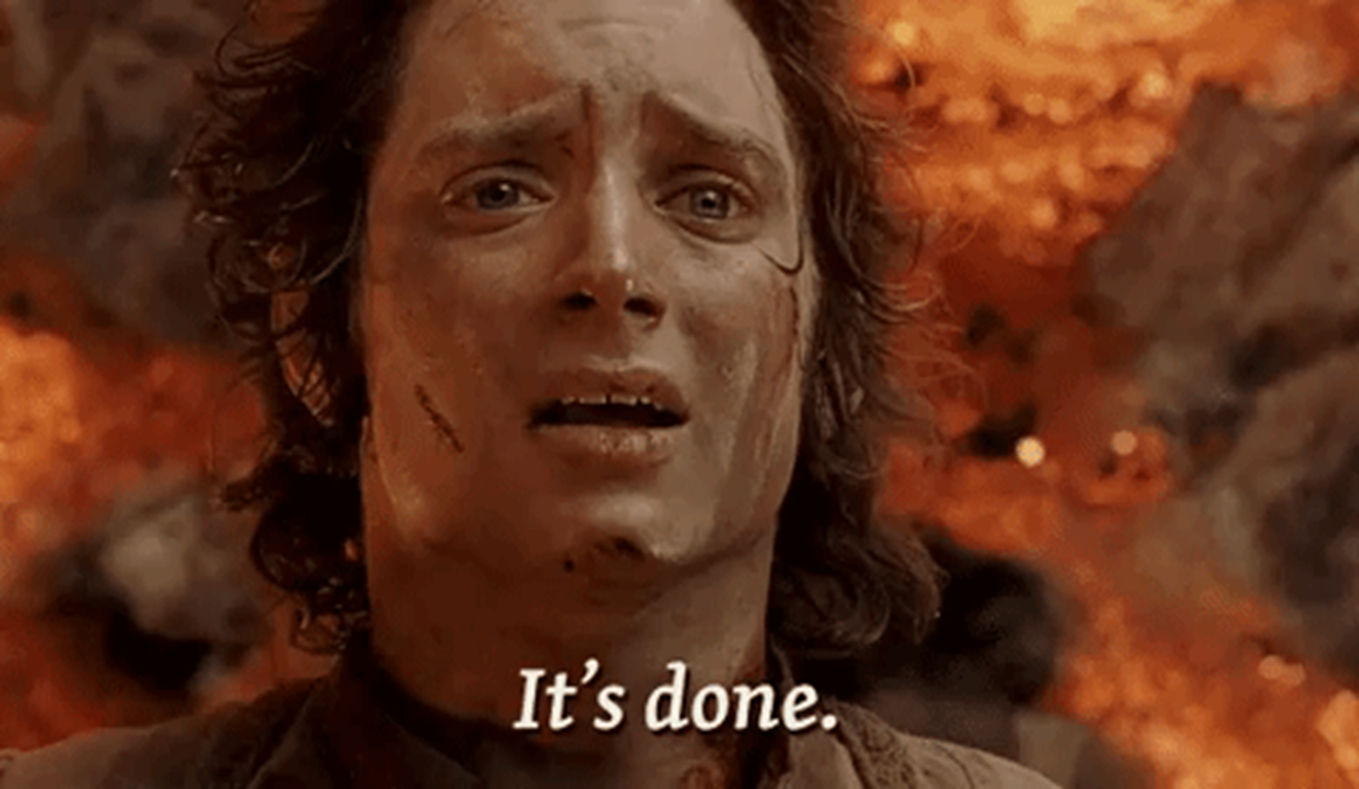

Slide 36
Listening Comprehension
Context (spoilers alert ☺): Beatrice Kiddo (Uma Thurman), a former assassin who had decided to hang up her sword and lead a normal life, wreaks vengeance on Bill and his team of assassins after they betrayed her, and left her for dead on the day of her marriage with Tommy Plimpton. In the extract, Beatrice has finally managed to track Bill down. Yet, Bill has retaliated and shot Beatrix with a dart containing a truth serum. Now he wants to know more about Beatrice’s story.
Watch the conversation between Beatrice and Bill, and answer the questions.
https://ecampus.unicaen.fr/mod/resource/view.php?id=207760

Slide 37
Answers ☺
Who is Bill’s favourite superhero?
A:Superman
According to Bill, what is this superhero’s drawback?
A: Not a great comic book, not well drawn
What do superheroes usually have to do to become superheroes?
A: They have to put on a costume

Slide 38
Continued…
Who is the exception?
A:Superman – he stands alone
Why is he an exception? Be specific (= soyez précis). If you have trouble answering this question, turn to “Question 5 Quiz” to help you out ☺!
A: He was born superman, for example spiderman goes to sleep and wakes up peter parker, whereas Superman was born a hero. His alter ego is Clark Kent. His alter ego is a ‘normal human’

Slide 39
Continued…
Give 3 characteristics of Clark Kent:
weak
unsure of himself
coward
What does he represent?
A: Superman’s critique of the entire human race.
Who is Beatrice Kiddo’s alter ego? Do not mention the name, but rather the kind of person.
A: Arlene Plimpton She tries to disguise herself as a ‘normal person’

Slide 40
Continued…
What does Beatrice Kiddo try to conceal under that identity?
Her life as a ‘superhero’ she tries to conceal her life as ‘a killer bee under that of a ‘worker bee’
So, in which way does Beatrice Kiddo resemble Clark Kent (hence Bill’s comparison between Beatrice Kiddo and Superman)?

Slide 41

Discussion/debate
Talk with the person next to you….
Do you think you would like to be a superhero? Why/why not?
What kind of responsibilities would you have?
What superpowers would you have?
What would your costume look like?
Would you have an alter ego or would you tell everyone who you were?

